Slide 1
C29PE Economics for Professionals
Week 1 – An Introduction
Sloman et al., 2023, Chapters 1,2 & 4

Slide 2
Welcome to the Course
Key Information
  Global course delivered across three campuses
Course Structure
  Microeconomics – Lectures (Weeks 1 to 5 & 7), and Tutorials (Weeks 3 to 5)
  Macroeconomics – Lectures (Weeks 8 to 12) and Tutorials (Weeks 8 to 12)
Assessment
  Class test: 30% of overall course mark; 1 hour duration, happening in Week 7
  Final exam: 70% of overall course mark; 2 hours duration, happening during the December diet – wait for announcement from the University
  Questions will be drawn from the whole course

Slide 3
Key staff for the course
Global course coordinator
  Dr. Suzanne Lampert s.lampert@hw.ac.uk
  Based in the Edinburgh campus, managing teaching across all campuses
Lecturers
  Dr. Hedieh Tajali [insert email] (Edinburgh)
  Mr. Javid Karimli J.Karimli@hw.ac.uk (Edinburgh)
  Dr. Hui Hon Chung H.Hui@hw.ac.uk (Malaysia)
Tutors
  Ms. Lydia Adeoye L.Adeoye@hw.ac.uk (Edinburgh)
  Dr. Hui Hon Chung H.Hui@hw.ac.uk (Malaysia)

Slide 4
Structure of the session
What do Economist’s Study?
  Tackling the Problem of Scarcity
Microeconomic Choices
  Choice and Opportunity Cost
  Rational Choices
  Marginal Costs and Benefits
  Microeconomic choices and the Firm
The Macroeconomic Environment
  Inflation, Unemployment, Balance of Trade, Economic Growth
  Macroeconomic Policy and its Effect on Business
  The Circular Flow of Income
Understanding the Business Environment
  What is business? Business economics? What determines business performance?
  PEST/STEEPLE analysis

Slide 5
References
Sloman et al (2023)
  Chapters 1.1-1.3
  Chapters 2.1-2.3
  Chapters 4.1-4.2
Important!
  The PowerPoint slide deck for Week 1 lecture provides a guideline of the topics you need to know. However, the materials in the slide deck are insufficient if you wish to excel in the course
  To do well, please do not forget to read the relevant sections of the core textbook
  Please also ensure that you follow economics news regularly as these sources could be used as examples to supplement your answers during assessments

Slide 6
What do Economist’s Study?
Activity – use one word to describe what you think economics is about; share your answer with the person sitting next to you

Slide 7
What do Economist’s Study?
Students who were asked what they think economics is about for the Oriana Bandiero, ‘What do economists do?’ video (what do economists do? – YouTube), responded with some of the following:
“money”
“banking”
“debt”
“finance”
“numbers”
If you watch the short clip, you will see that economics is about much more than this.

Slide 8
What do the following research topics/questions have in common?
What is the health impact of famines on survivors?
Is membership of urban youth clubs in Mali associated with greater trust and trustworthiness toward society?
What caused the US banking crisis?
How does inequality affect economic growth?
How do we explain the observed gap in earnings between men and women?
The roles of employers, healthcare professionals and occupational health staff in supporting employees with cancer
The effects of longer secondary school days on parents’ labour market outcomes
Air quality and inequalities in Colombia
A valuation of marine biodiversity in the Galapagos Islands
What are the costs associated with job creation and job destruction?
What are the alternatives to interest rates when trying to influence inflation, output and employment over the business cycle?

Slide 9
What do Economist’s Study?
You may never have studied economics before, yet you are constantly facing economic problems and making economic decisions.
Economics is relevant to ALL of us
For example: What should I buy? Should I save more today so I can spend more next year? Should I go to the supermarket or buy online? Should I go to university, or should I try and find a job now?
Firms – should we cut prices? Should we install new equipment? Should we diversify our products? Should we develop an environmental strategy?
Government – should we subsidise energy? How much should we invest in healthcare? Do we cut taxes? If so, when? For whom? Which ones?
Anybody studying economics today is doing so at an incredibly interesting, if not turbulent, time.

Slide 10
What do Economist’s Study?
What is it that makes a problem an economic problem?
There is one central problem faced by all, individuals, firms, governments and in all societies, no matter how rich they are. From this problem stem all other economic problems that we will be looking at.
This is the problem of scarcity.
Activity: Take 30 seconds to write a list of things that you want/want more of

Slide 11
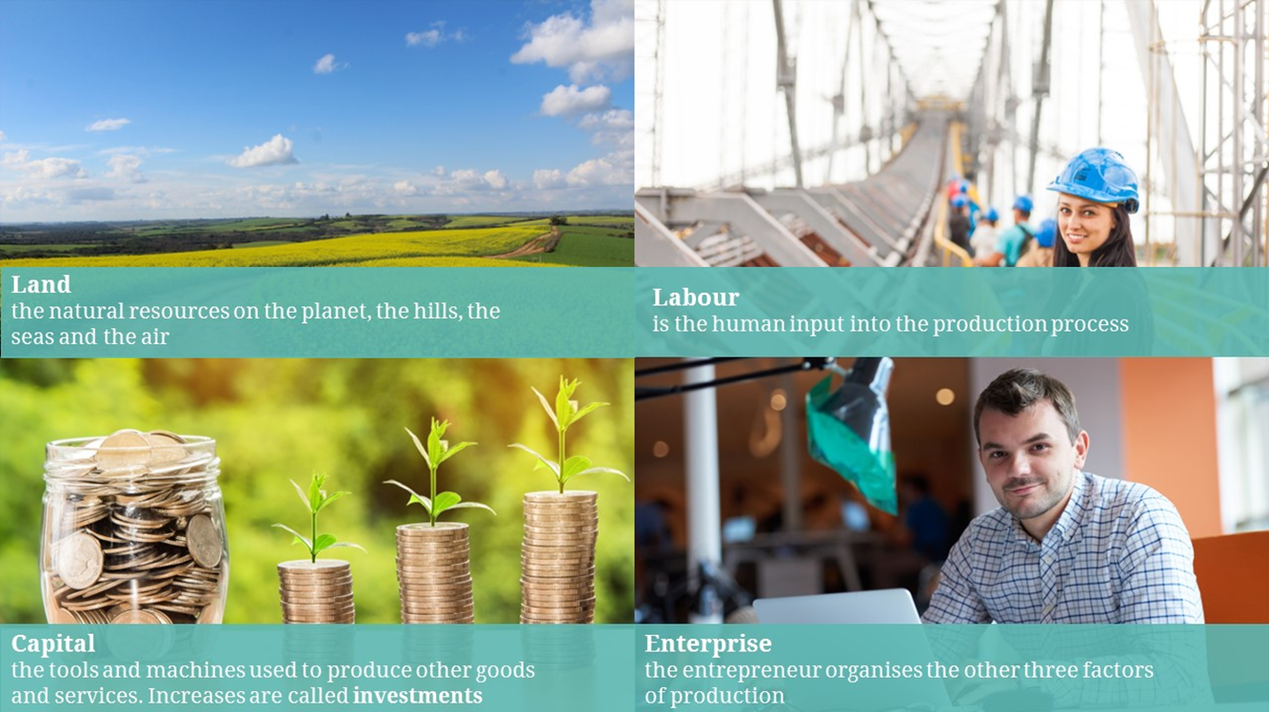
What do Economists Study?
Consumer wants are virtually unlimited
For example:
  A new car
  More clothes
  More holidays abroad
  More leisure time
  Faster medical treatment
Resources are limited
  Consumers - limited time, information and income
  Producers - limited resources
Resources
Importance of sustainability

Slide 12
The Economic Problem
Limited Resources
Unlimited Human Wants
Scarcity of Goods and Services
Scarcity is the excess of human wants over what can be produced to fulfil these wants.
Notes:
The limited resources are CELL
Capital
Enterprise
Land and Labour

Slide 13
Tackling the problem of scarcity
Tackling the problem of scarcity
  Scarcity - the excess of human wants over what can be produced.
  Because of scarcity, various choices must be made.
  We do not all face an equal problem of scarcity, but both rich and poor, want more than they can have.
  Two of the key elements in satisfying wants are therefore consumption and production.
  Consumption – economics studies how much the population spends; what the pattern of consumption is in the economy; and how much people buy of different items.
  Production – economics studies how much the economy produces in total; what influences the rate of growth of production; and why the production of some goods increases, and the production of others falls.
  We will be studying the way in which firms use their resources to produce goods and services and how consumers make their choices given the constraints they face.

Slide 14
Microeconomics Choices
There are three main categories of choice that must be made in any society:
What goods and services are going to be produced and in what quantities
How are things going to be produced
For whom are the things going to be produced?
These choices can be seen as microeconomic choices, since they are concerned not with the total amount of national output, but with the individual goods and services that make it up.
Answers to these questions depends on type of political system
In a command economy, there is a central authority (part of government)
In a (free) market economy, market (buyers and sellers) makes decisions
In a mixed economy, there is a role for both markets and government

Slide 15
The problem of economics is scarcity, which creates trade-offs.
Wherever there is scarcity we must make choices.
Opportunity cost explains the relationship between scarcity and choice, it is what you must give up to get something else.
Opportunity cost is the next best alternative foregone - the cost of any activity measured in terms of the sacrifice made in doing it.
See: https://www.youtube.com/watch?v=BQQ1HFobVPQ

Slide 16
Opportunity Cost
What are you sacrificing by choosing to study at university rather than taking a job that you have been offered?
Activity: write a list of the opportunity costs of being a student in higher education?
Notes:
The limited resources are CELL
Capital
Enterprise
Land and Labour

Slide 17
Opportunity Cost
Opportunity cost for businesses
  Examples
    If a car manufacturer can produce 10 small saloon cars with the same amount of inputs as it takes to produce 6 large saloon cars – the opportunity cost of producing one small car is 0.6 of a large car.
    If a taxi and car hire firm uses its cars as taxis, then the opportunity cost includes not only the cost of employing taxi drivers and buying fuel, but also the sacrifice of rental income from hiring its vehicles out.

Slide 18
Self-test activity – try this on your own
Measuring a firm’s opportunity costs
  Step 1. Discover which factors of production have been used
    Labour
    Land and raw materials
    Capital (consists of all those inputs that themselves have had to be produced in the first place, for e.g., factories, machines, transportation, and other equipment)
    Entrepreneurship (every ship needs someone at the wheel)
  Step 2. Measure the sacrifice involved in using the them

Slide 19
Marginal costs and benefits
The same principle applies to rational decisions made by consumers, workers and firms.
  For example, a car firm will weigh up the marginal costs and benefits of producing cars
  It will compare the costs and revenue of producing additional cars.
  If additional cars add more to the firm’s revenue than to its costs, it will be profitable to produce them.

Slide 20
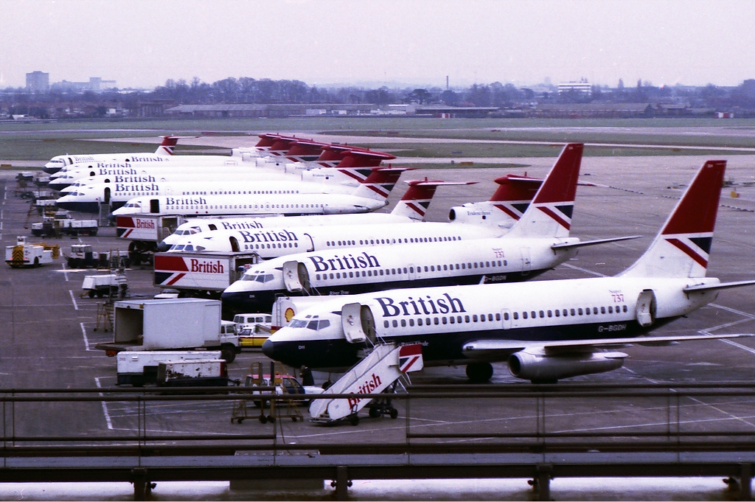
Example:
Airport Terminals
Terminal | Additional Benefits ($M) | Additional Costs ($M)
1 | 45 | 40
2 | 35 | 25
3 | 25 | 20
4 | 15 | 18
Here is the extra daily benefit and costs that would be derived from adding successive terminals at an airport to increase passenger handling capacity
Activity: How many terminals should be added?
Notes:
3 – stress the total costs/benefits and marginal costs/benefits

Slide 21
Marginal costs and benefits
In economics we argue that rational choices involve weighing up marginal costs and marginal benefits.
These are the costs and benefits of doing a little bit more or a little bit less of a specific activity.
They can be contrasted with the total costs and benefits of the activity.
  For example, what time will you set the alarm for tomorrow morning? If you need to leave home at 8.30am, will you set the alarm for 7am? That will give you plenty of time to get ready, but it will mean a relatively short night’s sleep. So perhaps you will set it for 7.30am or even 8am, even if that means you will be rushed.
  To make a rational decision about what time to set your alarm for, you can weigh up the costs and benefits of additional sleep.
  Each extra minute in bed gives you more sleep (the marginal benefit) but makes you more rushed when you get up (the marginal cost).
  The decision is therefore, based on the costs and benefits of extra sleep, not on the total costs and benefits of a whole night’s sleep.

Slide 22
Marginal costs and benefits
Opportunity cost and marginal analysis are both methods of resource allocation, and both assume that decision making is rational.
This is not always the case - behavioural economics is a field of economics that combines psychological insights with economic theory to better understand how people make decisions.
  The study of behavioural economics recognises that people do not always act in their own best interests or make decisions in a perfectly rational way, and that they are influenced by a variety of cognitive biases and emotional factors - for now, we will stick with rational decision making.
For now, we will assume that decision making is rational.

Slide 23
Sunk cost fallacy
Watch this: https://www.youtube.com/watch?v=jJajz9n9Oi4

Slide 24
Microeconomics
So far, we have focussed on microeconomics, and we will continue to do so for the next three weeks of lectures (and the first three tutorials).
Microeconomics is the branch of economics that studies individual units (e.g., households, firms and industries). It studies the interrelationships between these units in determining the pattern of production and distribution of goods and services.
We will now have a quick glance at macroeconomics (just to introduce it).

Slide 25
Macroeconomics
Because things are scarce, societies are concerned that their resources are being used as fully as possible, and that over time the national output should grow.
  The achievement of growth and the full use of resources is not easy, however, as demonstrated by the periods of high unemployment and stagnation that have occurred from time to throughout the world (e.g., the 1930s, the early 1980s and 1990s, the financial crisis of 2008-9 and the Covid-19 pandemic in 2020).
  Furthermore, attempts by governments to stimulate growth and employment often have resulted in inflation and a large rise in imports.
Macroeconomics studies the determination of national output and its growth over time.
It also studies the problems of stagnation, unemployment, inflation, the balance of international payments and cyclical instability, and the policies adopted by governments to deal with these problems.

Slide 26
What is happening in the economy?
What are the current economic issues affecting us as consumers, workers, business owners, societies?
Task: spend a few minutes searching news sites for some current economic issues.

Slide 27
What is happening in the economy?
Some examples (August 2024)
  UK economy continues recovery with 0.6% growth - BBC News
  UK inflation rate ticks up to 2.2% in first rise this year - BBC News
  Europe’s economic growth is extremely fragile (oclc.org)
  Bank of England cuts interest rate to 5% – Channel 4 News
  Abu Dhabi hotels attract 2.4 million visitors in five months | Property – Gulf News
  Abu Dhabi's new Rental Index will help clarify rates on new leased homes | Property – Gulf News
  Malaysia's Rapid Development Ideals Must Incorporate Sustainability – BusinessToday
  Japan's Import Growth In Line With Malaysia's Shipment (businesstoday.com.my)
Whilst most of the above are macroeconomic issues, they will impact the decision making of individual consumers, firms and industries. The macroeconomic environment is very important to individual consumers, firms and industries.

Slide 28
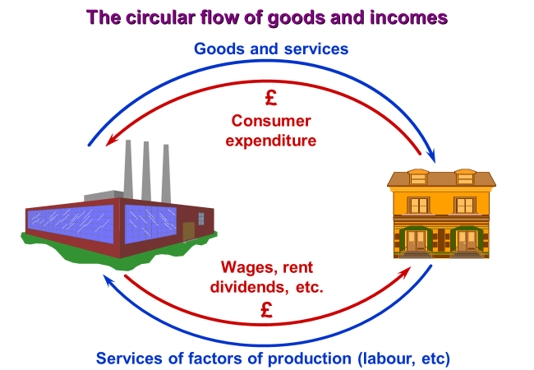
The Circular Flow of Income
One of the most useful diagrams for illustrating the macroeconomic environment and the relationship between producers and consumers is the circular flow of income diagram.
The consumers of goods and services are labelled ‘households’ (and represented by the house)
Some members of households are also workers or owners of other factors of production, such as land.
The producers of goods and services are labelled ‘firms’ (and represented by the factory)
Firms and households are in a twin ‘demand and supply’ relationship.

Slide 29
The Circular Flow of Income
First, households demand goods and services and firms supply goods and services.
Money flows from households to firms and goods and services flow from firms to households.
This coming together of buyers and sellers is known as the market.
Second, firms demand the use of factors of production owned by households (labour, land and capital) and households supply them.
The services of labour and other factors flow from households to firms. In exchange, firms pay households money (wages, rent, dividends, and interest).
This is a factor market, for e.g., the market for bricklayers.

Slide 30
The Circular Flow of Income
Macroeconomics is concerned with the total size of the flow.
If consumers choose to spend more, firms will earn more from the increased level of sales (feeds into economic growth)
Firms will probably respond by producing more (feeds into economic growth and unemployment levels) or raising their prices (feeds into the inflation rate), or some combination of the two.
As a result, they will end up paying more out to workers in the form of wages (feeds into inflation), and to shareholders in the form of profits (feeds into inflation and economic growth).
Households will thus gain additional income, and this will lead to an additional increase in consumer spending, and therefore, a further boost to production (feeds into inflation, economic growth and unemployment levels).
This effect does not go on indefinitely. When households earn additional incomes, not all of it is spent – some will be saved (influenced by government policy), some will be paid in taxes (depends on government policy), and some will be spent on imports (non-domestic goods and services) (feeds into balance of trade)

Slide 31
The impact of the macroeconomy on individuals and businesses
Activity – think about/discuss with the person next to you the following questions:
Why does economic growth matter to us as individuals?
Why does economic growth matter to businesses?
Why does unemployment matter to us as individuals?
Why does unemployment matter to businesses?
Why does inflation matter to us as individuals?
Why does inflation matter to businesses?
Why does government policy matter to us as individuals?
Why does government policy matter to businesses?

Slide 32
The business environment
What do we mean by a business?
  Typically, an organisation which makes good or provides services
  Sells goods and services to people, who use them (weeks 2 – 3)
  Uses the revenue from sales to pay its costs (weeks 3 – 4)
    Wages to employees
    All its other operating costs
    For investment in new equipment and processes
    And keeps any money left over as profit
  We assume that businesses do all their buying and selling through markets

Slide 33
What is business economics?
Understanding decision making in business
  from the economic perspective of thinking about market exchange
  Important for us to consider
    external influences on the firm – the business environment
    decisions which the firm makes itself (internal decisions)
    external effects of business decision making (the effects on society)
What do business economists do?
  Describe – what we can observe happening in businesses and markets
  Analyse – what would be the effects of changes in market conditions
  Recommend – how businesses should change their behaviour

Slide 34
Determinants of business performance
Structure → Conduct → Performance
How business structure affects business conduct (behaviour)
  Competitive markets imply competitive behaviour
    Will look at this in detail in weeks 4 – 5: small firms, low profits
  Market power implies limited competition and collusion
    Larger firms – higher profits – which is more efficient?
  Performance indicators for businesses include profitability, market share, growth in market share, share prices

Slide 35
For the business – is the main objective profit maximisation
  Or will firms have other goals?
Consider the internal organisation of (large) businesses
  Owners appoint managers to act in their interests
  Managers have their own objectives
    May be interested in salary, turnover, staff size, reward without effort
  Owners and managers can be in conflict
    Many interesting problems – principal-agent
Self-test activity: What are other factors affecting business performance?

Slide 36
Tools for analysing business environment
One way to think about the business environment is to use PEST analysis
Case study: the EV market in Malaysia (or other country)
  (P) Political factors: what are the political factors affecting development of an EV industry in Malaysia
  (E) Economic factors: what are the economic factors?
  (S) Social factors?
  (T) Technological factors?
A similar framework is the STEEPLE analysis (example here)
More on this during the tutorial

Slide 37
Summary
Economist’s study the problem of scarcity.
Microeconomic choices are made at the individual consumer, firm or industry level
  To help with these choices, we use the concept of opportunity cost
  For now, we will focus on rational choices (weighing up the marginal costs and marginal benefits)
  At the firm level, these choices involve decisions about what goods and services to produce, how to produce them and for whom.
Macroeconomic studies the determination of national output and its growth over time
  It all studies the problems of stagnation, inflation, unemployment, the balance of international payments and cyclical instability, and the policies adopted by governments to deal with these problems.
  The circular flow of income illustrates the relationship between producers and consumers.
Important to understand the business environment; PEST/STEEPLE analysis are useful methods to analyse business environment

